Slide 1



The position and size of the brand logo MUST not
be changed.
In case you are using a dark backround image
Please use the white letter logo version.
Space for items such as „1924 established“, „100 years or also other promotional items.
Size of these 2 items please always like in examples below.
You can also use a blue bar with hightlight text as shown in examples.
This special promotional logo can also be used implemented in the main grafic.
There are versions available with and without frame. When using no frame please use the version with the blue full width footer as shown in examples below.
There are 4 different versions of the footer. Which can be used flexible.
Enjoy it.
www.blaupunkt.com

Slide 2
HIGHLIGHT YOUR CATEGORY
SINGLE TEASER LINE. MYRIAD PRO BOLD CAPITAL
Enjoy it.
www.blaupunkt.com

Slide 3
Enjoy it.
www.blaupunkt.com

Slide 4
HIGHLIGHT YOUR CATEGORY
FIRST LINE TEXT CAPITAL LETTERS BOLD
Second line Myriad Pro regular letters
Enjoy it.
www.blaupunkt.com

Slide 5
HIGHLIGHT YOUR CATEGORY
Enjoy it.
www.blaupunkt.com

Slide 6
Enjoy it.
www.blaupunkt.com

Slide 7
Enjoy it.
www.blaupunkt.com

Slide 8
HIGHLIGHT YOUR CATEGORY
FIRST LINE TEXT CAPITAL LETTERS BOLD
Second line Myriad Pro regular letters
Enjoy it.

Slide 9
FIRST LINE TEXT CAPITAL LETTERS BOLD
Second line Myriad Pro regular letters
Enjoy it.

Slide 10
FIRST LINE TEXT CAPITAL LETTERS BOLD
Second line Myriad Pro regular letters
Enjoy it.

Slide 11
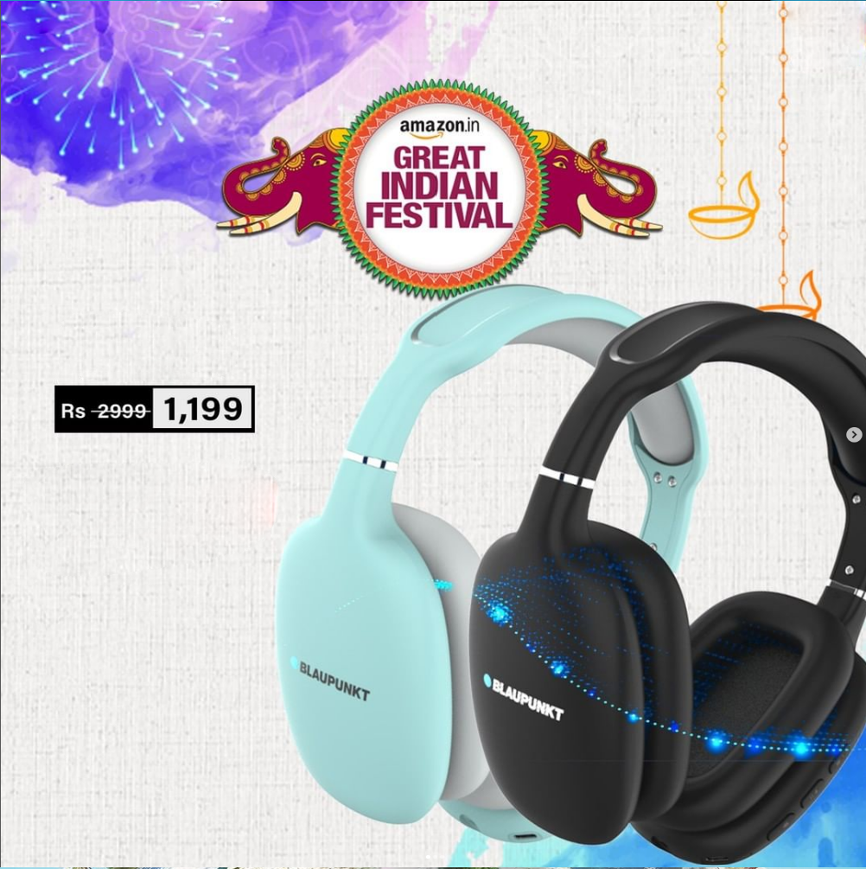

NOW EXCLUSIVELY AT AMAZON
BH 31
TURBO VOLT FAST CHARGING
Enjoy it.
www.blaupunkt.com

Slide 12
BH 31
TurboVolt
Fast Charging
Enjoy it.
www.blaupunkt.com

Slide 13
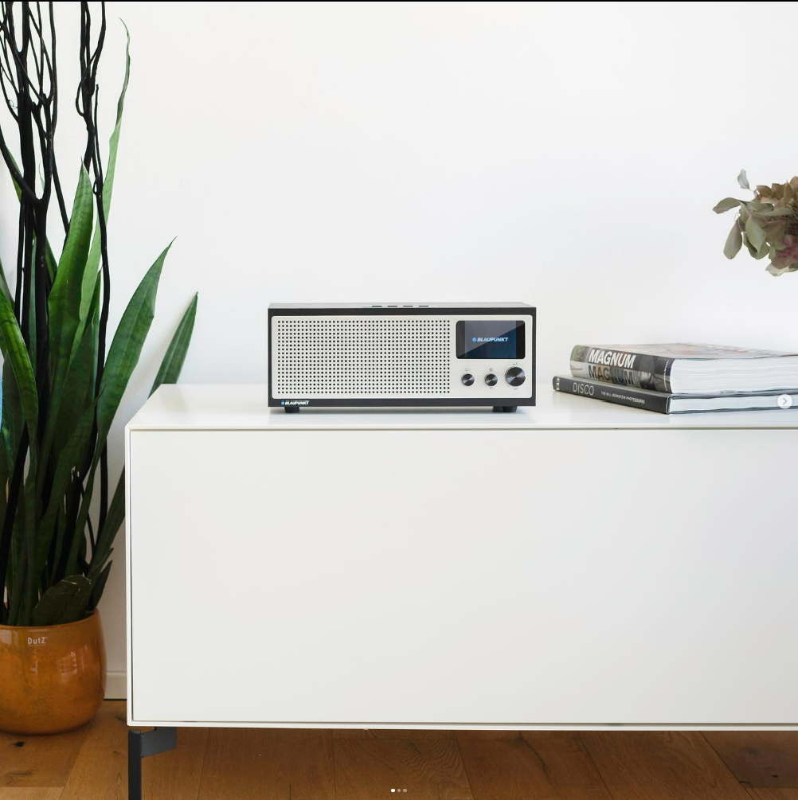
Enjoy it.
www.blaupunkt.com

